Slide 1


Problem Solving with the Internet of Things and Python
Unit 3 - CircuitPython

Slide 2
Lab 4
Introduction to CircuitPython

Slide 3
What is CircuitPython?
Python 3 →→→→→ MicroPython →→→→→ CircuitPython

Slide 4
We know Python, so what is MicroPython?
Python 3 →→→→→ MicroPython →→→→→ CircuitPython

Slide 5
MicroPython
Kickstarter
MicroPython.org

Slide 6
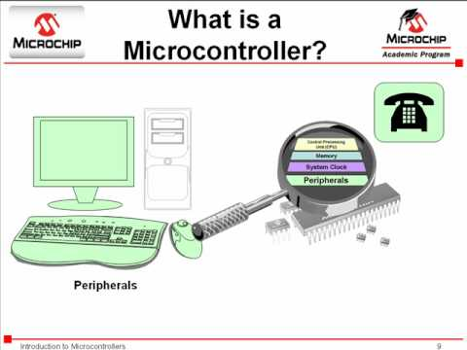
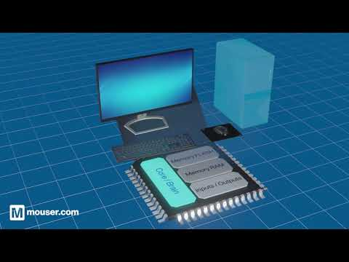
What is a microcontroller?

Slide 7
What is a microcontroller?
A microcontroller is small computer
A microcontroller is the brains of our IoT device
Sometimes called an embedded system
A microcontroller is programmed to perform a specific task

Slide 8
Common microcontrollers
Intel MCS51 (8051) - 8051 Photo
Microchip PIC - PIC Photo
Arduino - Arduino Photo
Adafruit Feather - Feather Photo

Slide 9
MicroPython
MicroPython was developed to program microcontrollers with a version of Python.
Developers wanted to harness the many benefits of the Python programming language.

Slide 10
What about CircuitPython?
Python 3 →→→→→ MicroPython →→→→→ CircuitPython

Slide 11
What about CircuitPython?
CircuitPython

Slide 12
Which microcontroller are we using?
Adafruit Feather Bluefruit Sense

Slide 13
More resources
https://www.theengineeringprojects.com/2018/03/introduction-to-microcontrollers.html
https://www.youtube.com/watch?v=W9jjgKaE1_k (about the Adafruit Feather family)
https://learn.adafruit.com/adafruit-feather-sense
https://learn.adafruit.com/todbot-circuitpython-tricks/overview

